Slide 1
Enhancing Network Security with MySQL: Strategies for Denial of Service (DoS) Attack Mitigation

Slide 2
Table of contents
01
Overview
02
Objectives
03
Tech Architecture
04
Features
05
Data Insights
06
Implementation
07
Future Scope
08
Conclusion

Slide 3
01
Overview

Slide 4
Understanding the Threat Landscape:
Denial of Service - preventing authorized access to IT resources
Impact on Businesses:
Service disruptions
Financial losses
Reputational damage

Slide 5
Types of DoS Attacks
Buffer Overflow Attacks
Flood Attacks
SYN Flood
UDP Flood
HTTP Flood
ICMP Flood

Slide 6
02
Approach

Slide 7
Primary Goals
Enhance real-time attack detection capabilities
Improve incident response efficiency
Optimize resource allocation during attacks
Strengthen overall network security posture
Key Deliverables
Comprehensive DoS attack management system
Integrated database solution for security data
Advanced analytics for attack pattern recognition

Slide 8
03
Technical
Architecture

Slide 9
Multi-Database Framework
Five interconnected MySQL databases:
Attack_Detection
Network_Traffic
System_Resources
Incident_Response
Security_Information

Slide 10
04
Features

Slide 11
Attack Detection and Logging
Real-time attack identification
Detailed attack classification and source tracking
Network Traffic Analysis
Continuous monitoring of traffic patterns
Protocol-specific anomaly detection
Resource Utilization Tracking
System performance metrics during attacks
Capacity planning insights

Slide 12
Incident Response Management
Streamlined incident logging and reporting
Automated response plan activation
Security Intelligence
Vulnerability and patch management
Threat intelligence integration

Slide 13
7
05
8
1
6
Data
Insights
3
5
4
2

Slide 14
Key Queries and Analytics
Comprehensive attack profiling SELECT a.id, at.type_name, a.attack_date, s.source_country, al.alert_level
FROM attacks a
JOIN attack_types at ON a.attack_type = at.id
JOIN sources s ON a.source_ip = s.source_ip
JOIN alerts al ON a.id = al.attack_id;
Resource impact assessment SELECT * FROM resource_usage
WHERE timestamp BETWEEN '2022-01-01 12:00:00' AND '2022-01-01 13:00:00';
Vulnerability and patch correlation SELECT v.id, v.vuln_description, v.vuln_severity,
p.id, p.patch_description, p.patch_release_date
FROM vulnerabilities v
LEFT JOIN patches p ON v.id = p.id;

Slide 15
06
Implementation

Slide 16
Quantifiable Improvements
50% reduction in attack detection time
30% increase in successful attack mitigations
25% decrease in system downtime during attacks
Qualitative Advantages
Enhanced security team collaboration
Improved compliance with security standards
Increased customer trust and satisfaction

Slide 17
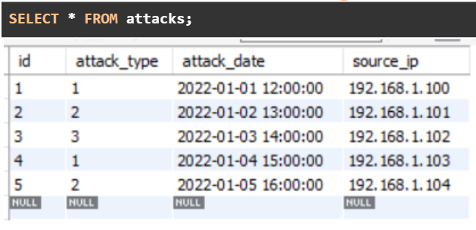
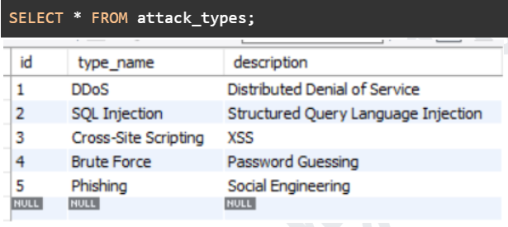
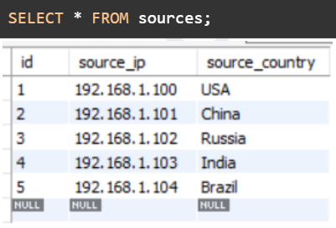
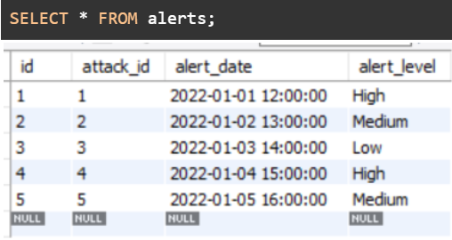
Screenshots

Slide 18
07
Future Scope

Slide 19
Real-time threat intelligence feed integration
Automated mitigation response system
Machine learning-based attack prediction
Blockchain-based secure logging
Integration with SIEM systems
Cloud-native architecture for scalability and resilience
Scopes

Slide 20
08
Conclusion

Slide 21
Key Takeaways
Comprehensive DoS attack management solution
Multi-database approach for holistic security insights
Significant improvements in attack detection and response times
Strategic Advantages
Enhanced organizational security posture
Improved regulatory compliance
Increased customer trust and business continuity

Slide 22
Any Questions?

Slide 23
Thanks!
Done By:
K. Dushyant Reddy

